Slide 1


ADVENTURE WORKS
Group 6

Slide 2
TEAM CONTRIBUTION
Aryan & Ranjesh
Performed data cleaning (handling missing values, removing duplicates)
Worked on data modeling and combining datasets into a master table
Rashmi & Nishant
Designed and developed interactive dashboards
Created KPIs (Key Performance Indicators)
Added filters/slicers for better user interaction
Built visualizations (charts, graphs) for better understanding of data

Slide 3



INTRODUCTION
The organization shared Eight Excel datasets containing sales-related information.
All datasets followed a uniform structure with identical columns, making them suitable for consolidation.
The data consisted of key fields such as product, sales value, transaction date, and region.
This project focuses on data cleaning, merging, and analysis to extract meaningful business insights.

Slide 4
OBJECTIVE
To analyze sales data provided in multiple Excel sheets
To clean and standardize the dataset for accurate analysis
To combine all datasets into a single master sheet
To create a structured table for better data organization
To solve 13 analytical questions using Excel tools
To perform the same analysis using Excel, Power BI, SQL, and Tableau
To create interactive dashboards for better data visualization
To generate meaningful business insights for decision-making
To improve skills in data analysis and visualization tools

Slide 5


DATASET DESCRIPTION
The dataset used is based on Adventure Works sales data
It contains important fields such as:
Category (e.g., Bikes, Accessories)
Sub-Category (e.g., Mountain Bikes, Helmets)
Region (sales location)
Year (sales year)
Month (monthly sales data)
Sales Amount (revenue generated)
The data is structured and consistent, making it suitable for analysis
It helps in understanding sales trends, regional performance, and product performance

Slide 6
PLANNING THE ANALYSIS
Understanding the dataset: Reviewed fields like Category, Sub-Category, Region, Year, Month, and Sales
Defining objectives: Planned to answer 13 business questions and generate insights
Data collection & organization: Gathered all 8 Excel sheets in one place
Data cleaning plan: Checked for missing values, duplicates, and consistency
Data merging strategy: Combined all sheets into one master dataset
Tool selection: Chose Excel, Power BI, SQL, and Tableau for analysis and visualization
Dashboard planning: Decided to create interactive dashboards for better understanding of trends

Slide 7


TOOLS USED
Microsoft Excel – for data cleaning, merging sheets, and basic analysis
SQL – for querying and managing structured data
Power BI – for creating interactive dashboards and visualizations
Tableau – for advanced data visualization and dashboard design
Computer/Laptop – for performing analysis and handling datasets

Slide 8


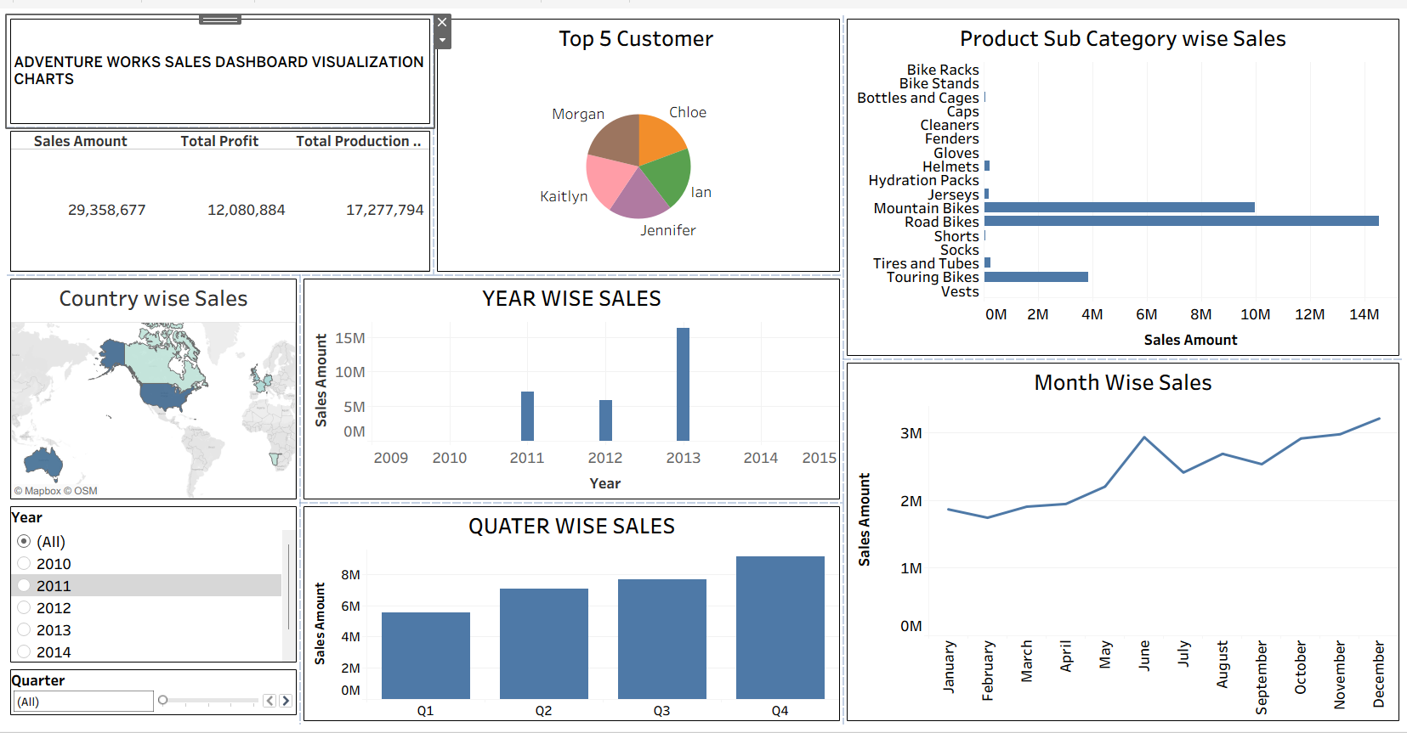
DASHBOARD

Slide 9
SKILLS GAINED
Developed strong data analysis skills using tools like Microsoft Excel, Power BI, Tableau, and SQL
Improved ability in data cleaning and data preparation
Learned to combine multiple datasets into a single master dataset
Gained experience in creating dashboards and visualizations
Enhanced problem-solving and analytical thinking skills
Developed business insight generation from raw data
Improved technical and presentation skills

Slide 10
CONCLUSION
The project successfully analyzed sales data from the Adventure Works dataset
Multiple Excel sheets were cleaned, merged, and converted into a single master dataset
A structured table was created to simplify analysis and improve accuracy
All 13 analytical questions were solved using tools like Microsoft Excel, SQL, Power BI, and Tableau
Interactive dashboards helped in visualizing trends and patterns effectively
The project provided valuable business insights such as sales trends, regional performance, and product performance
Overall, it enhanced data analysis, visualization, and decision-making skills

Slide 11

THANK YOU

